Slide 1
Chapter 8: Newton’s law of universal gravitation
Presented by Joseph Farley

Slide 2
History of Gravity
Aristotle
Earth at center of universe; “force” moves things towards the states in which they belong
Copernicus
Different model of universe; something missing
Galileo
Relation between “gravity” and mass
Kepler
Laws of planetary motion; Sun drove “gravity” system
Newton
Derives law of universal gravity from Kepler’s

Slide 3
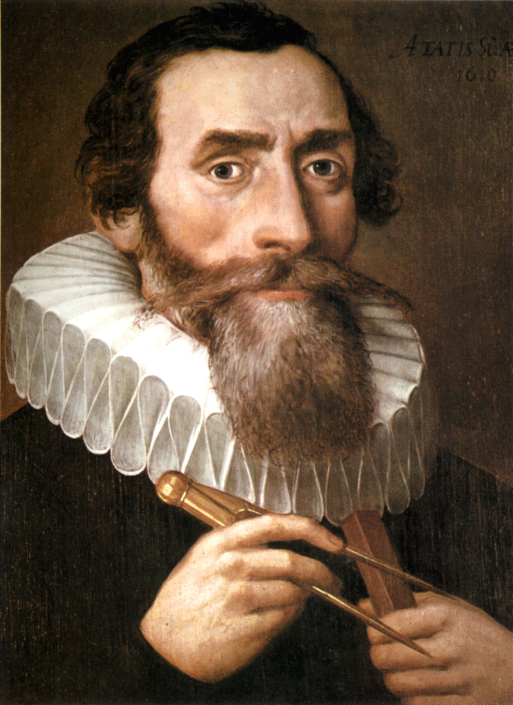
Johannes Kepler – 1570 to 1630
German mathematician, astronomer, astrologer, and “natural philosopher”
Copernican – heliocentricism
Defended and strengthened model
Three Laws of Planetary Motion
Provided foundation for Newton’s arguments concerning universal gravitation

Slide 4
Kepler’s Laws of Planetary Motion
The orbit of a planet is an ellipse with the Sun at one of the two foci.
A line segment joining a planet and the Sun sweeps out equal areas during equal intervals of time.
**The square of the orbital period of a planet is proportional to the cube of the semi-major axis of its orbit.**

Slide 5
Kepler’s Laws of Planetary Motion
The orbit of a planet is an ellipse with the Sun at one of the two foci.
A line segment joining a planet and the Sun sweeps out equal areas during equal intervals of time.
**The square of the orbital period of a planet is proportional to the cube of the semi-major axis of its orbit.**
R³
τ²
Constant

Slide 6
Newton’s Principia – Law of Universal Gravity
First: Six deductions from astronomical data and observations to support Kepler’s Laws
Involves heavenly bodies orbiting one another
Next: Develops propositions about nature of forces necessary to produce these phenomena
Kepler’s laws require a central, inverse-square force

Slide 7
Inverse-Square Law
1
R²
Must be the case for Kepler’s laws to be true
Derived from Argument for Centripetal Acceleration
Centripetal – Inward force
Centrifugal – Outward force (opposite)
Leads to derivation of the law of attraction
4π²m
R²
F_{c}
Constant

Slide 8
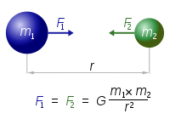
Law of Gravitation for Point Masses
Generalized the previous equation for all masses, not just the Sun
Force seems to be propagated instantaneously
https://www.youtube.com/watch?v=p_o4aY7xkXg

Slide 9
Issue with Equation
Previous equation was for point masses, but planets are not point masses
Newton worried greatly about this and why it should hold for extended spheres.
Theorized about homogenous spherical shell
Inside shell – no net force experiences
Outside shell – experience force as if it were coming from center of sphere (center of mass)
Simple calculus exercises exist to prove this by summing individual parts

Slide 10
Something to Think About
Consider an object with two different physical properties:
One property relates to a resistance to change in the object’s motion
Another property relates to the objects capacity to exert and feel attraction from other objects
Are these properties the same? Could they be? What does that imply?
What could these two properties be?
Mass and electrical charge of a point charge?

Slide 11
Inertial Mass vs. Gravitational Mass
Newton considers these two properties to be different in his laws, but are they different?
He does not use these terminologies
No reason exists for these masses to be related in any way
Newton supports the idea that they are close to the same through experimentation with pendulums
Must be the same for other previously established laws to be true
Is there any proof or reasoning for this yet?

Slide 12
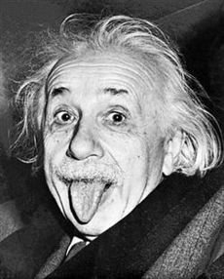
Thank You Einstein!!
https://www.youtube.com/watch?v=IM630Z8lho8

Slide 13
Additional Videos
Football
https://www.youtube.com/watch?v=m-5CDVdglp4
Size of Solar System
https://www.youtube.com/watch?v=zR3Igc3Rhfg

